Slide 1
Microarray-Based Expression Profiling for Identification of Differentially Expressed Genes and Related Pathways in Breast Cancer
Sayeda Rehmat | VU ID: BC190408541
Supervised by: Saddia Bano
Department: Department of Biological Sciences
Virtual University of Pakistan

Slide 2
Outline
Introduction
Objectives
Methodology
Results
Conclusion

Slide 3
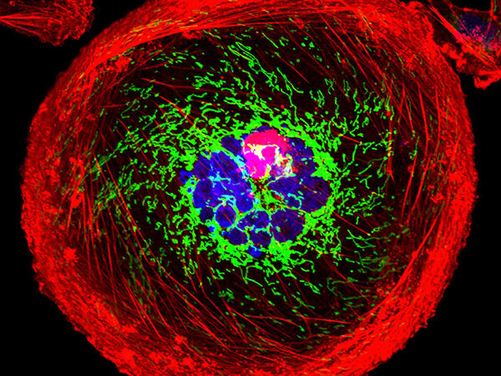
Introduction (Breast Cancer)
Breast cancer is one of the most common types of cancer in women, making up about 1 in 4 cancer cases
The breast is not a vital organ for staying alive, and early-stage breast cancer is not life-threatening.
Cancer cells are abnormal, they don’t stick together well and can break off easily.
These cells can then travel through the blood or lymph system and spread to other parts of the body (this is called metastasis).
Even though diagnosis and treatment have improved, many patients still face poor outcomes and survival rates.
Notes:
Ginsburg O, Bray F, Coleman MP, Vanderpuye V, Eniu A, Kotha SR, et al. The global burden of women’s cancers: a grand challenge in global health. Lancet. 2017;389(10071):847–60.
Allahverdiyev A, Tari G, Bagirova M, Abamor ES. Current approaches in development of immunotherapeutic vaccines for breast Cancer. J Breast Cancer. 2018;21(4):343–53.
Muller A, Homey B, Soto H, Ge N, Catron D, Buchanan ME, et al. Involvement of chemokine receptors in breast cancer metastasis. Nature. 2001;410(6824):50–6.

Slide 4

Why Gene Expression Studies?
Old methods can only look at a few genes at a time, so they don’t give the full picture.
Gene expression studies (like microarrays) let scientists study thousands of genes at once.
This helps us better understand how cancer works at the genetic level.
It’s useful for:
Finding early signs (biomarkers) of cancer
Discovering new treatment targets
Understanding why some cancers grow fast or resist treatment
Overall, it helps doctors give more accurate and personalized treatments.

Slide 5
Objectives of the study
⦁ Identification of related metabolic pathways of breast cancer
2
⦁ Identification of differentially expressed genes
1

Slide 6
Dataset Information
GSE15852 (43 breast tumor, 43 normal)
Source: GEO database
Platform: Affymetrix Human Genome U133A Array

Slide 7
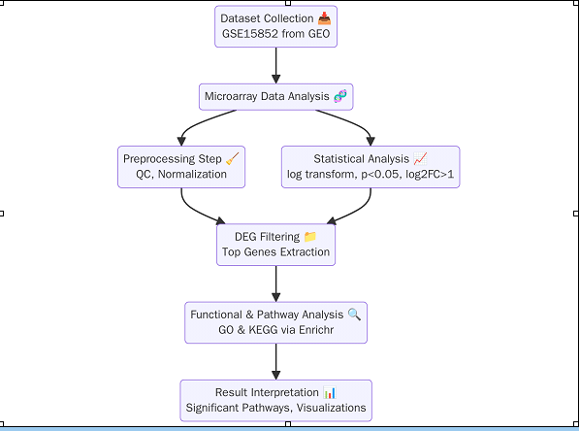
Workflow Diagram

Slide 8
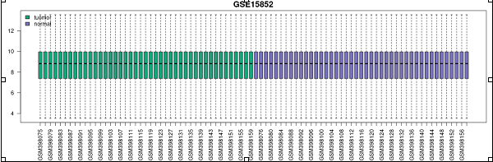
Results
Box Plot (QC)
Confirms successful normalization of samples
Comparable distribution across tumor and normal groups

Slide 9
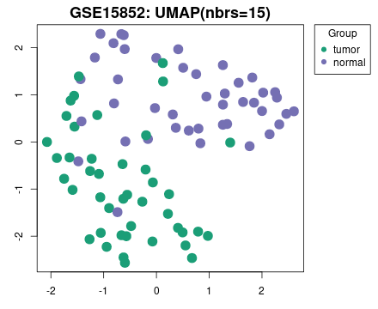
UMAP Plot
“This UMAP shows that tumors cluster separately from normals, which confirms that our dataset can distinguish disease vs healthy samples.”

Slide 10
Dataset | Threshold | Total no. of Differentially Expressed Genes
GSE15852 | p value < 0.05 FC < -1 | FC > 1 | 22,283

Slide 11
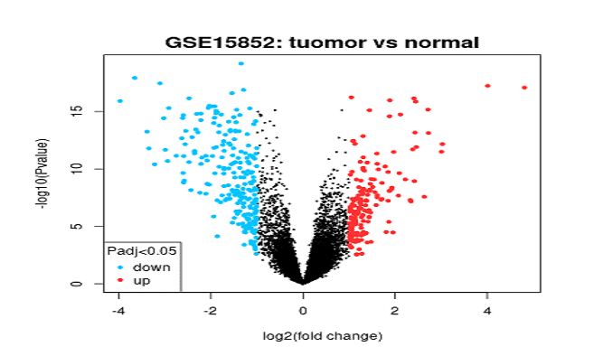
Volcano Plot
Visualizes significant DEGs
Red = upregulated, Blue = downregulated

Slide 12
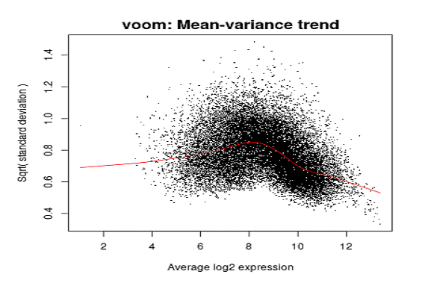
Voom Plot
Displays mean–variance relationship
Confirms variance modelling suitability

Slide 13
Pathway Enrichment Analysis
Term | No of genes
Pathways in cancer | 85
Breast Cancer | 26
Proteoglycans in cancer | 49

Slide 14
Genes Enriched in the Breast Cancer Pathway in GSE15852
Genes | Log2FC
RB1 | -0.226344
FLT4 | 0.090087
LEF1 | 0.423752
PTEN | 0.105720
FGF2 | -0.040633
EGFR | -0.071073
IGF1R | 0.076756
FGF5 | -0.192238
ERBB2 | -0.248987
E2F3 | -0.069058
HES1 | 0.198759
FZD1 | -0.084788

Slide 15
Genes Enriched in the Breast Cancer Pathway in GSE15852
Gene | Log2FC
JUN | 0.168994
FZD5 | -0.074398
FZD4 | 0.629876
CSNK1A1 | -0.059070
FZD7 | -0.071162
WNT5A | 0.017050
IGF1 | -0.030359
FOS | 0.114189
ESR1 | 0.244603
CDK4 | 0.098931
FGF18 | -0.089761
CTNNB1 | -0.103093
SOS1 | -0.029171
FGFR1 | -0.147828

Slide 16

Discussion

Slide 17
Gene | Description
CDK4 | CDK4 is a cell cycle regulator. Its upregulation promotes uncontrolled cell division by allowing cells to pass through the G1/S checkpoint, contributing to tumor growth. This explains why CDK4/6 inhibitors are effective in breast cancer treatment.
FGF18 | FGF18 is part of the fibroblast growth factor family that normally drives cell growth and angiogenesis. Here it is slightly downregulated, suggesting that these cancer samples may not depend heavily on FGF18 for progression.
CTNNB1 | CTNNB1 encodes β-catenin, a key player in the Wnt pathway. Its downregulation may indicate reduced β-catenin activity, but since other Wnt genes are up, the pathway overall still appears active. This balance influences tumor invasion and survival.
SOS1 | SOS1 links receptor tyrosine kinases to the RAS/MAPK pathway. Its slight downregulation suggests weaker activation of this growth pathway in these samples.
FGFR1 | FGFR1 is a receptor for fibroblast growth factors. Normally, its amplification drives aggressive tumors, but its downregulation here suggests it is not a major driver in these breast cancer samples.
FZD5 | FZD5 is a receptor in the Wnt pathway. Its downregulation suggests it plays a smaller role in Wnt signaling here, compared to other Frizzled receptors like FZD4.
FZD4 | FZD4 is strongly upregulated, showing very active Wnt signaling. This promotes stemness, tumor progression, and therapy resistance, making it a key gene in this dataset.
CSNK1A1 | CSNK1A1 is a kinase that regulates β-catenin stability in Wnt signaling. Its slight downregulation may alter Wnt signaling balance, influencing cancer cell survival.
FZD7 | FZD7 is another Wnt receptor. Its downregulation suggests it is not the dominant Wnt activator here, unlike FZD4 which is strongly up.
Notes:
Hanahan D, Weinberg RA. The hallmarks of cancer. Cell. 2000;100:57–70. doi: 10.1016/s0092-8674(00)81683-9
Pardee AB. G1 events and regulation of cell proliferation. Science. 1989;246:603–608. doi: 10.1126/science.2683075.
Hellman S: Dogma and inquisition in medicine. Breast cancer as a case study. Cancer 1993; 71: 2430-2433.
Senosain MF, Massion PP. Intratumor Heterogeneity in Early Lung Adenocarcinoma. Front Oncol 2020;10:349
DeSantis CE, Ma J, Goding Sauer A, Newman LA, Jemal A. Breast cancer statistics, 2017, racial disparity in mortality by state. CA Cancer J Clin 2017;67(6):439–48.
. Xu, Y. Liu, T. Zhang, et al.
The global, regional, and national burden and trends of breast cancer from 1990 to 2019: results from the Global Burden of Disease Study 2019
Front Oncol, 11 (2021), Article 689562
Harbeck N, Gnant M. Breast cancer. Lancet. 2017;389:1134–1150. doi: 10.1016/S0140-6736(16)31891-8
Florea A, Sangaré L, Lowe K. A Multinational assessment of gastric, esophageal, and colorectal cancer burden: a report of disease incidence, prevalence, and fatality. J Gastrointest Cancer. 2020;51:965–71. doi: 10.1007/s12029-019-00328-4
L Yang ¹, X Wu, Y Wang, K Zhang, J Wu, Y-C Yuan, X Deng, L Chen, C C H Kim, S Lau, G Somlo, Y Yen
Affiliations Expand
PMID: 21532620
DOI: 10.1038/onc.2011.145

Slide 18
Gene | Description
WNT5A | WNT5A is a Wnt ligand. Its slight upregulation suggests some contribution to non-canonical Wnt signaling, which supports invasion and metastasis.
IGF1 | IGF1 normally stimulates growth through IGF1R. Its downregulation suggests reduced ligand-driven signaling, though IGF1R itself is slightly upregulated.
FOS | FOS is part of the AP-1 transcription factor. Its upregulation supports estrogen signaling and drives cancer cell growth and invasion.
ESR1 | ESR1 encodes the estrogen receptor alpha (ERα). Its upregulation confirms that these breast cancers are estrogen-dependent, typical of luminal subtypes.
ERBB2 | ERBB2 (HER2) is normally amplified in HER2+ cancers. Its downregulation here indicates these cancers are not HER2-driven, possibly luminal or basal-like subtypes.
E2F3 | E2F3 controls cell cycle gene expression. Its downregulation may reduce E2F-driven proliferation, but other cell cycle pathways are active, such as CDK4 upregulation.
HES1 | HES1 is a transcription factor in the Notch pathway. Its upregulation helps maintain cancer stem-like properties and therapy resistance.
FZD1 | FZD1 is a Wnt receptor. Its downregulation indicates it is not strongly contributing to Wnt signaling in these samples.
JUN | JUN, along with FOS, forms the AP-1 complex. Its upregulation drives transcription of genes involved in proliferation and survival.
Notes:
DeSantis CE, Fedewa SA, Goding SA, et al. Breast cancer statistics, 2015: Convergence of incidence rates between black and white women. Cancer J Clin. 2016;66(1):31–42. doi: 10.3322/caac.21320.
Ruan W, Kleinberg DL. Insulin-like growth factor I is essential for terminal end bud formation and ductal morphogenesis during mammary development. Endocrinology. 1999;140:5075–81. doi: 10.1210/endo.140.11.7095
Darnell JE., Jr Transcription factors as targets for cancer therapy. Nat. Rev. Cancer. 2002;2:740–749. doi: 10.1038/nrc906
Society AC. Breast Cancer Facts & Figures 2017–2018, 2017.
Stein RA, Staros JV. Evolutionary analysis of the ErbB receptor and ligand families. J Mol Evol. 2000;50(5):397–412.
S. Sundarraj et al.
γ-Sitosterol from Acacia nilotica L. induces G2/M cell cycle arrest and apoptosis through c-Myc suppression in MCF-7 and A549 cells
J Ethnopharmacol
(2012)
DeSantis CE, Ma J, Gaudet MM. et al. Breast cancer statistics, 2019. CA Cancer J Clin. 2019;69:438–51. doi: 10.3322/caac.21583.
Schenkelaars Q, Fierro-Constain L, Renard E, Hill AL, Borchiellini C. Insights into Frizzled evolution and new perspectives. Evol Dev. 2015;17(2):160–9
Gupta G. P., Massagué J. (2006) Cell 127, 679–695

Slide 19
Gene | Description
LEF1 | LEF1 is a Wnt transcription factor. Its strong upregulation shows active Wnt/β-catenin signaling, which supports tumor growth and invasion.
PTEN | PTEN is a tumor suppressor that inhibits the PI3K/AKT pathway. Surprisingly, it is slightly upregulated here, which may represent a subtype where PTEN is retained.
FGF2 | FGF2 usually promotes angiogenesis and tumor growth. Its slight downregulation suggests weaker contribution to cancer progression in this dataset.
EGFR | EGFR is important in triple-negative breast cancer. Its downregulation here suggests these samples are not strongly dependent on EGFR signalling.
IGF1R | IGF1R is a receptor that promotes survival and endocrine resistance. Its upregulation here shows that IGF signaling remains active despite lower IGF1 levels.
FGF5 | FGF5 promotes angiogenesis and growth. Its downregulation suggests it is not playing a strong role in these breast cancers.
RB1 | RB1 is a tumor suppressor controlling the cell cycle. Its downregulation removes cell cycle brakes, promoting uncontrolled tumor cell division.
FLT4 | FLT4 (VEGFR3) drives lymphangiogenesis. Its upregulation indicates higher potential for lymph node spread in breast cancer.
Notes:
Abreu de Oliveira WA, El Laithy Y, Bruna A, Annibali D, Lluis F. Wnt signaling in the breast: From development to disease. Front Cell Dev Biol. 2022;10:884467. doi: 10.3389/fcell.2022.884467
Li D.M., Sun H. TEP1, Encoded by a Candidate Tumor Suppressor Locus, is a Novel Protein Tyrosine Phosphatase Regulated by Transforming Growth Factor Beta. Cancer Res. 1997;57:2124–2129.
Kalluri R, Zeisberg M. Fibroblasts in cancer. Nat Rev Cancer. 2006;6(5):392-401.
M.D. Green
Gefitinib treatment in hormone-resistant and hormone receptor-negative advanced breast cancer
Ann. Oncol.
(2009)
Ruan W, Kleinberg DL. Insulin-like growth factor I is essential for terminal end bud formation and ductal morphogenesis during mammary development. Endocrinology. 1999;140:5075–81. doi: 10.1210/endo.140.11.7095.
Sanli O, Dobruch J, Knowles MA, et al. Bladder cancer. Nat Rev Dis Primers. 2017;3:17022. doi: 10.1038/nrdp.2017.22.
Siegel R, Ma J, Zou Z, Jemal A. Cancer statistics, 2014. CA Cancer J Clin. 2014;64:9–29. doi: 10.3322/caac.21208.

Slide 20
Conclusion
The project successfully identified key gene expression changes and associated biological pathways in breast cancer.
These findings contribute to the growing body of molecular knowledge on breast cancer and provide potential leads for future biomarker discovery.

Slide 21
Thank You

